Slide 1



YouTube
Global Statistics
Presented By:
Wajahat Ali
Roll No.:
5121145
Data Science 5th

Slide 2



CONTENTS
Introduction
Project Overview
Power BI
Dashboard Overview
Data Cleaning & Filtering
Visualization and Analysis
Data Insights and Trends

Slide 3


Introduction
Video-Sharing Platform: YouTube is a popular video-sharing platform where users can upload, share, and view a wide variety of videos.
Global Reach: YouTube has a global audience, allowing content creators to reach viewers worldwide and facilitating cultural exchange through shared content.
User Engagement: Viewers can engage with videos by liking, disliking, commenting, and subscribing to channels, fostering a dynamic and interactive community.
Additionally, users can access information about content creators, exploring details such as their channel information, upload history, and any accolades or recognitions they have received.
YouTube is available for both mobile and desktop users.

Slide 4
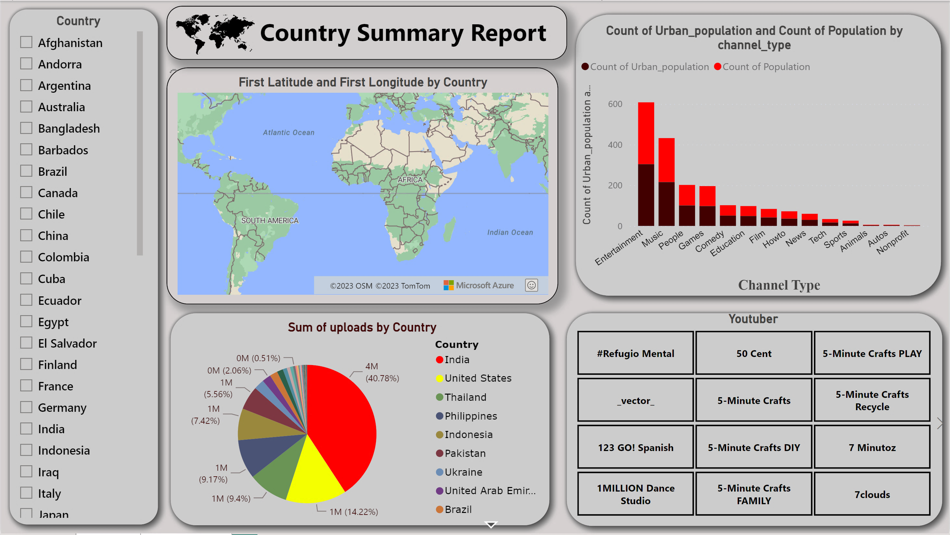
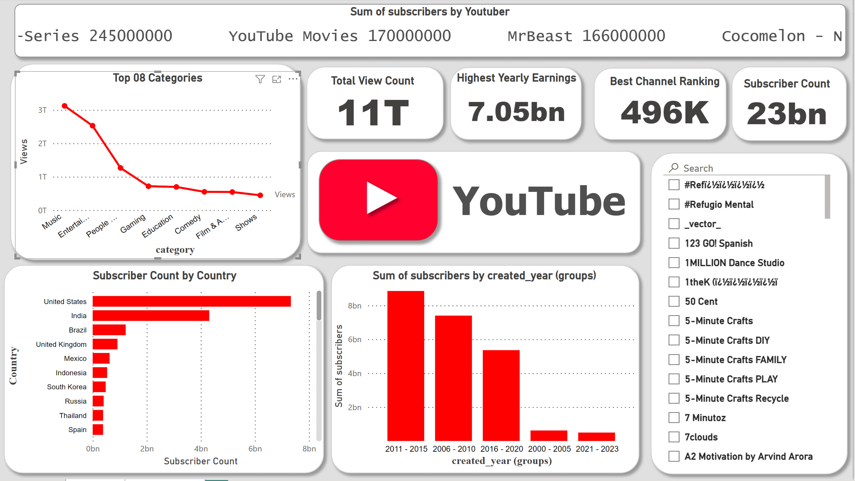
Dashboard Overview
This Power BI homepage is dedicated to analyzing the global statistics dataset of YouTube. It features Multiple charts, each serving a distinct purpose, including stacked bar charts and cards.

Slide 5
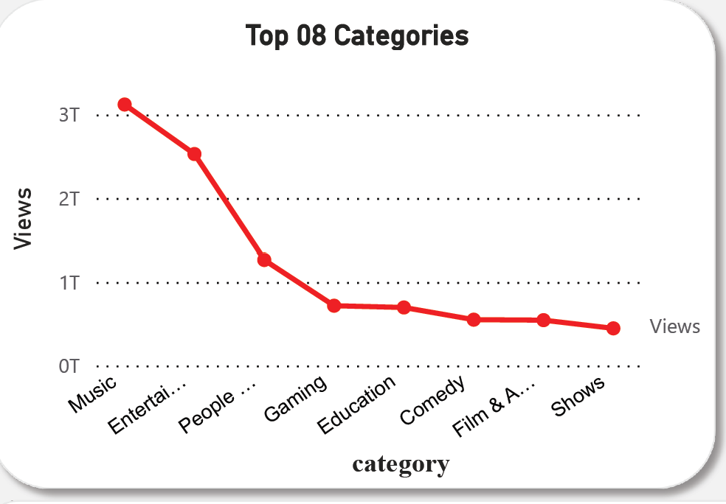
Line Chart
Top 08 Categories
In this line chart, we can discern a distinct pattern of total views across various content categories. Notably, the "Music" category exhibits the highest total views on the Y-axis, followed by "Gaming," "People," "Education," "Shows," and "Comedy." This graphical representation provides valuable insights into the relative popularity and viewer engagement within each content category.
Music
Gaming
Education
Movies

Slide 6
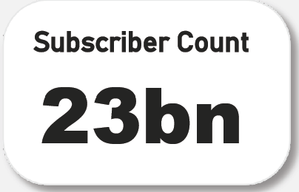
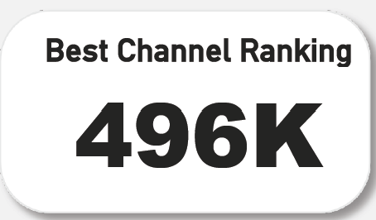
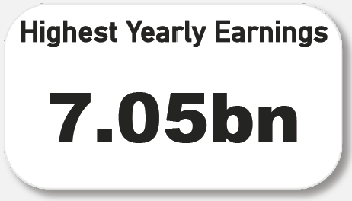
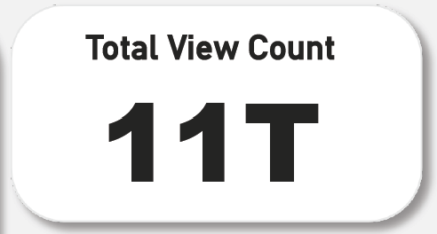
Cards
03:33
03:33
03:33
03:33
This Cards shows Total number of Subscriber on YouTube
This Cards shows Total number of Ranking Channel on YouTube
This Cards shows Total number of Highest Earning on YouTube
This Cards shows Total number of Views on YouTube
Subscriber
Views
Channels
Total Subscriber Count
23 bn
Total View Count
11 bn
Best Ranking Channel
496K

Slide 7

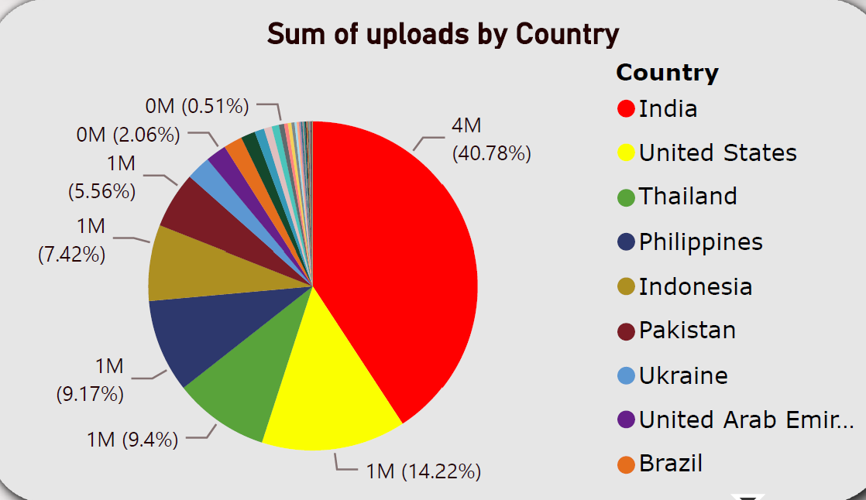
Pie Chart (Sum of uploads by Country)
India
4M
United States
1M
In this pie chart, each segment represents a country, and the size of each segment corresponds to the total number of uploaded videos from that specific country. The legend provides a clear breakdown of the countries, while the values showcase the respective sums of uploaded videos. This visual representation allows for a quick and insightful overview of the distribution of video uploads among different countries.

Slide 8
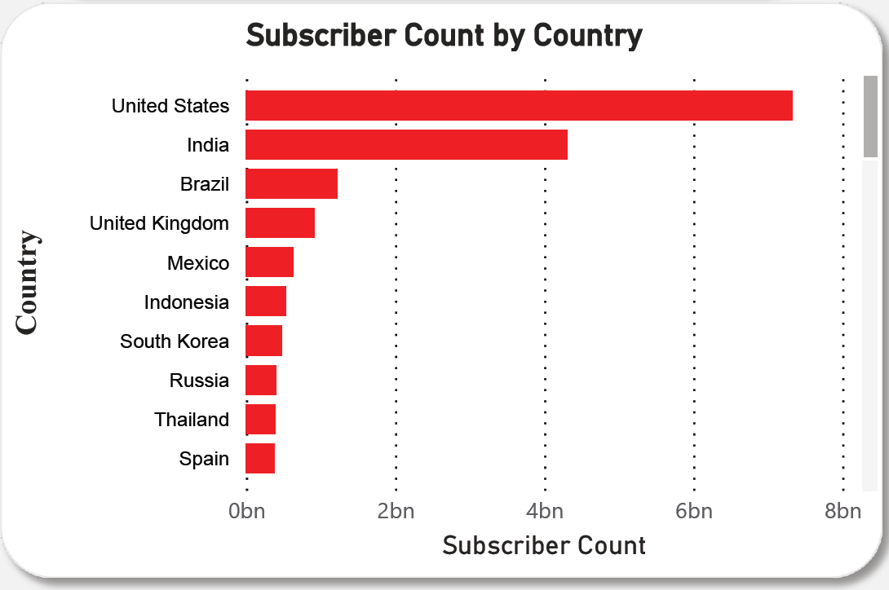
Stack Bar chart (Subscriber Count by Country)
United States
7.3 bn
India
4.3 bn
Brazil
1.3 bn
In this stack bar chart, the Y-axis represents various countries such as the United States, India, Brazil, and more. The X-axis corresponds to the subscriber count, with each bar stacked to showcase the distribution of subscribers within each country. The height of each stacked segment reflects the subscriber count from a specific country, providing a visual comparison of subscriber distribution across the selected countries. This type of chart is effective in illustrating the relative contribution of each country to the overall subscriber count.

Slide 9
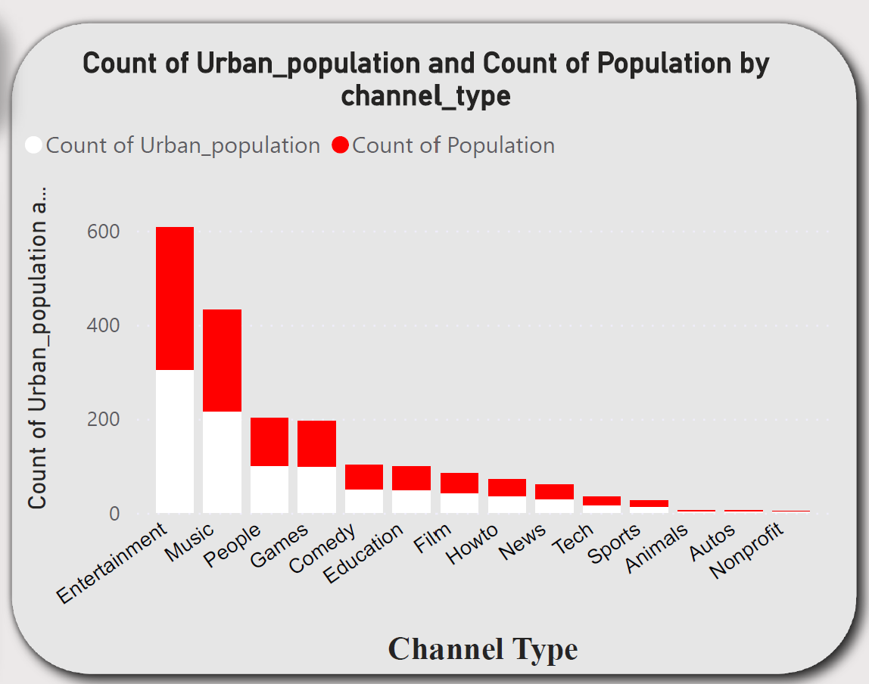
Stack Column chart (Population Count by Country)
In this stack column chart, the Y-axis represents the count of urban population, depicted in white, and the total population, shown in red, for individuals who watch YouTube. The X-axis categorizes different content genres, including "Music," "Gaming," "People," "Education," "Shows," and "Comedy." Each column is divided into two stacked segments, with the white portion representing the urban population and the red portion indicating the total population. This visual representation allows for a comparison of the urban population's contribution to the overall viewership across various content categories.

Slide 10
Help
Search help
key points focus on leveraging Power BI to analyze and visualize YouTube data, providing actionable insights for content creators and stakeholders to enhance their understanding of viewer behavior and optimize content strategies.
Category-wise Viewer Engagement: Implement a comprehensive analysis of YouTube data based on content categories (e.g., music, gaming, people, education, shows, comedy) to understand viewer preferences. Utilize Power BI to create visualizations such as bar charts, line charts, or pie charts to showcase trends and patterns in viewer engagement across these categories.
Create a detailed subscriber analytics report using stack column charts or other relevant visualizations. Highlight the distribution of subscribers across content categories and explore trends in subscriber growth or decline over time. This analysis can provide valuable information for content creators and marketing teams.
Utilize maps and geographical visualizations in Power BI to showcase the geographic distribution of YouTube viewership. Identify regions with high and low engagement, helping content creators tailor their strategies to target specific audiences or expand their reach in untapped regions.
Develop key performance indicators (KPIs) related to content performance, such as likes, shares, and comments. Utilize Power BI's capabilities to create scorecards, tables, or trend analyses to monitor the success of different content categories. This information can guide content creators in refining their strategies and producing more appealing content to their audience.

